Slide 1

Neural Substrates of Attention and Awareness
Dan Birman
Gardner Lab
Lightning Talks – 2015-04-23

Slide 2


Slide 3


Slide 5
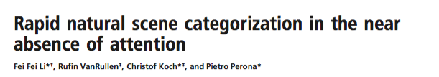

Slide 6
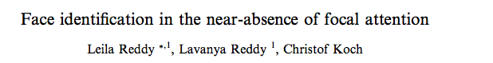

Slide 7
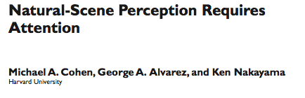

Slide 9
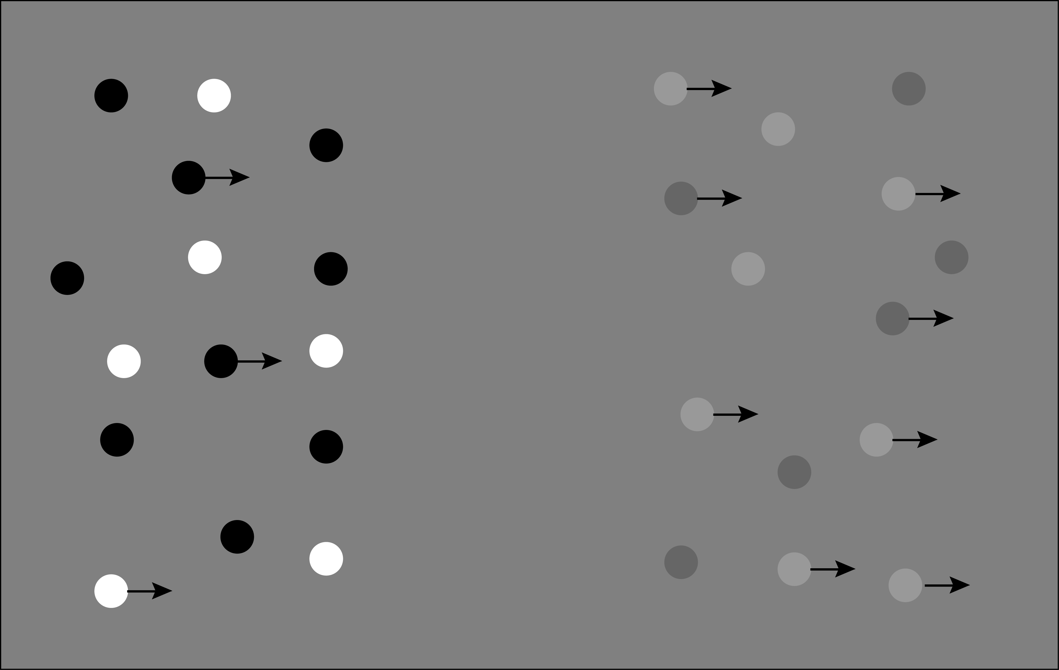

Slide 10
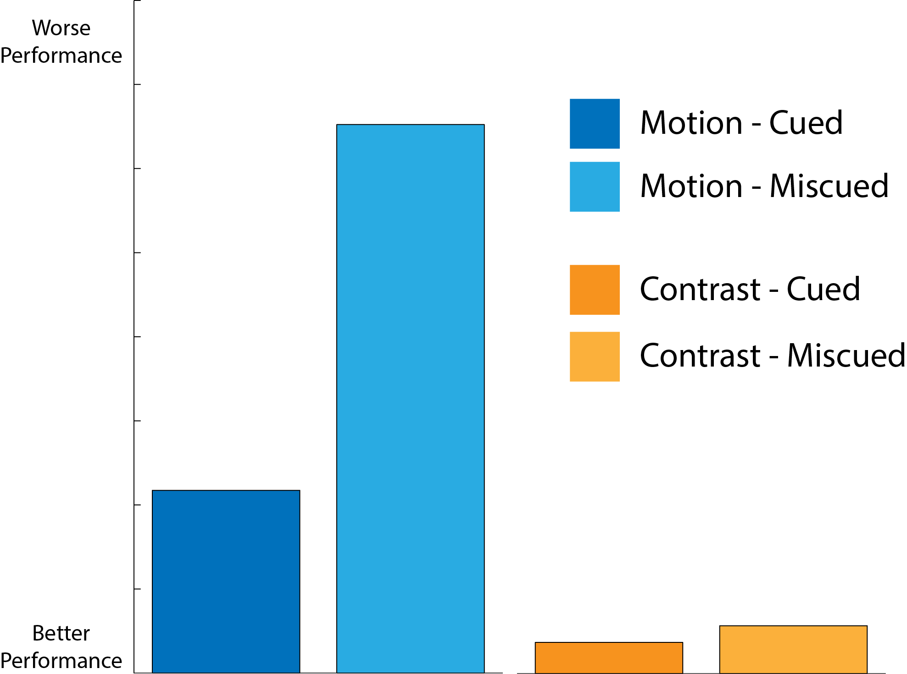
Worse
Performance
Better
Performance

Slide 11
Worse
Performance
Better
Performance

Slide 12
Worse
Performance
Better
Performance

Slide 13
Worse
Performance
Better
Performance

Slide 14
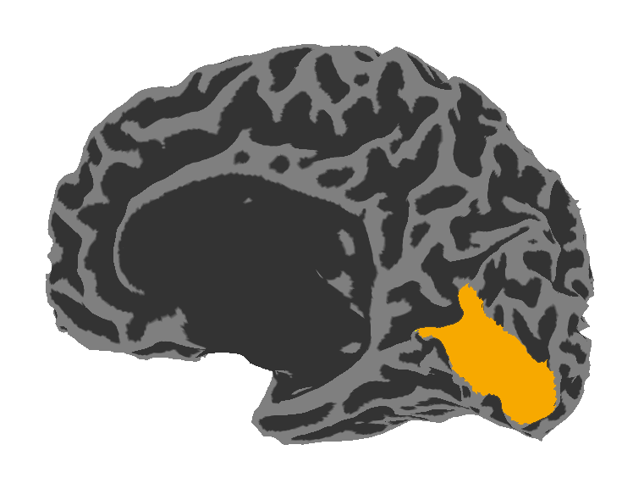
Visual Area V1:
Sensitive to Contrast

Slide 15
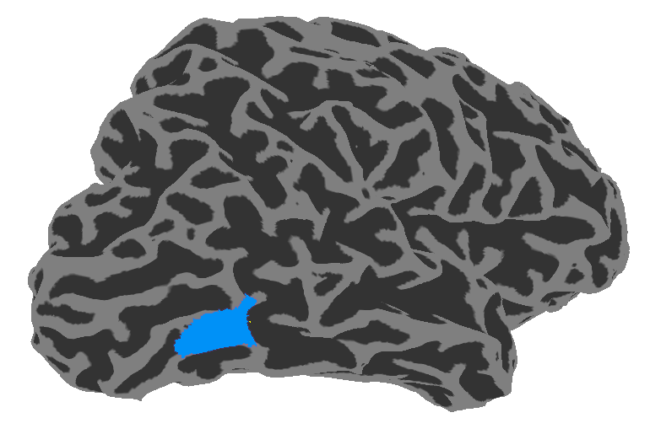
Visual Area V1:
Sensitive to Contrast
Visual Area hMT:
Sensitive to Motion Coherence

Slide 16
Stimulus Strength
Stimulus Strength

Slide 17
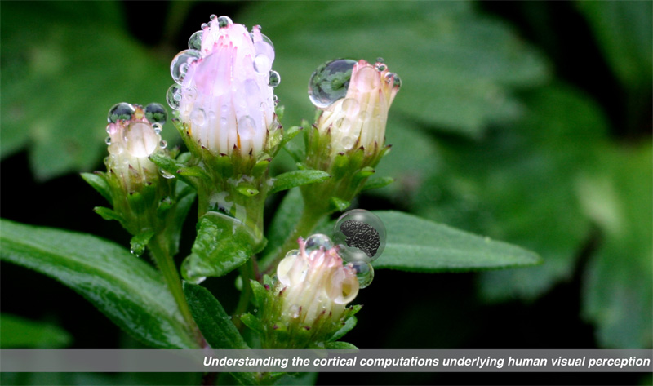

Gardner Lab @ Stanford University
Justin Gardner

